Slide 1

Lesson no 8
Radar Jamming
Protection

Slide 2
01. Antenna Protection Measures
CONTENTS
02. Transmitter Protection Measures
03. Receiver Protection Measures

Slide 3
01. Antenna Protection Measures

Slide 4
Sidelobe suppression (SLS)
Electronic scanning
Polarization

Slide 5
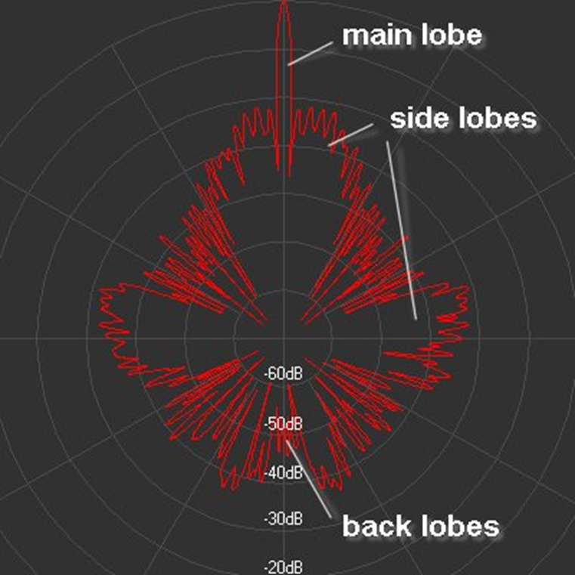

Slide 7
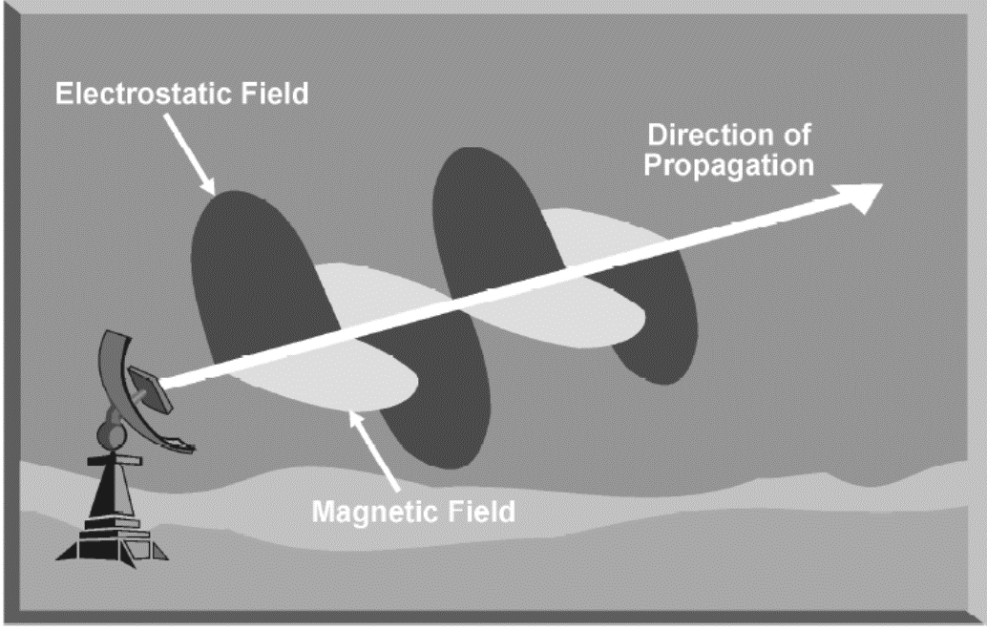

Slide 9
02. Transmitter Protection Measures

Slide 10
Low power emission
Large bandwidth available
Frequency hoping
Coherence
Modulation

Slide 12
Low power emission

Slide 13
Large bandwidth available
Frequency hoping

Slide 14
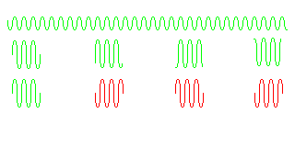
Coherence

Slide 15
Modulation

Slide 16
Modulation

Slide 17
Modulation

Slide 18
03. Receiver Protection Measures

Slide 19
Receiver manual IF gain (MAN GAIN or IF GAIN)
Automatic gain control (AGC)
Passive angle tracking (PAT)
Moving target indication (MTI)

Slide 20
Thanks

